Slide 1
Real time face recognition system using LBPH and LBP Cascade Classifier
Abel Athallah C.
17/415893/PA/18162

Slide 2
Face Recognition? Face Detection?
Note that face recognition is different of face detection:
Face Detection: it has the objective of finding the faces (location and size) in an image and probably extract them to be used by the face recognition algorithm.
Face Recognition: with the facial images already extracted, cropped, resized and usually converted to grayscale, the face recognition algorithm is responsible for finding characteristics which best describe the image.

Slide 3
Face Recognition?
A technology that capable of identifying or verifying a face of a person from a digital image or a live video frames.
In general, it works by comparing selected facial features that is from given image with faces which stored in a database.
Face recognition has become so popular that now it is widely used in many embedded systems such as smartphone to be used as a biometric authentication for unlocking their phones.

Slide 4
What’s a biometric authentication?
It has the definition to be used as a means of identification and access control.
This includes the defining data samples of biological characteristics of human being to identify unique individual, such as facial features and fingerprints.

Slide 5
What are Local Binary Patterns?
• Local Binary Patterns, or LBPs for short, are a texture descriptor made popular by the work of Ojala et al.
• Unlike Haralick texture features that compute a global representation of texture based on the Gray Level Co-occurrence Matrix, LBPs instead compute a local representation of texture.

Slide 6
Why LBP feature?
It is simple
Fast
Robust to a various environment (lightning conditions)
Has shorter training time
Robust to an occlusion

Slide 7
What & Why LBPH?
Local Binary Pattern Histogram is a very popular face recognizer / recognition model. It has significant improvement over a Fisherfaces and Eignfaces algorithm as they’re still affected by lightning condition when they try to recognize the facial image, hence it is more robust than the other two algorithm.

Slide 8
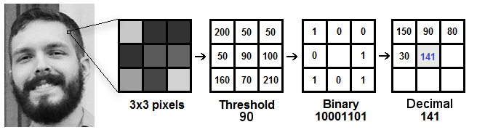
LBPH works by finding the local structure of the image as it compares each pixel to its neighbor pixels.
i) https://towardsdatascience.com/face-recognition-how-lbph-works-90ec258c3d6b

Slide 9
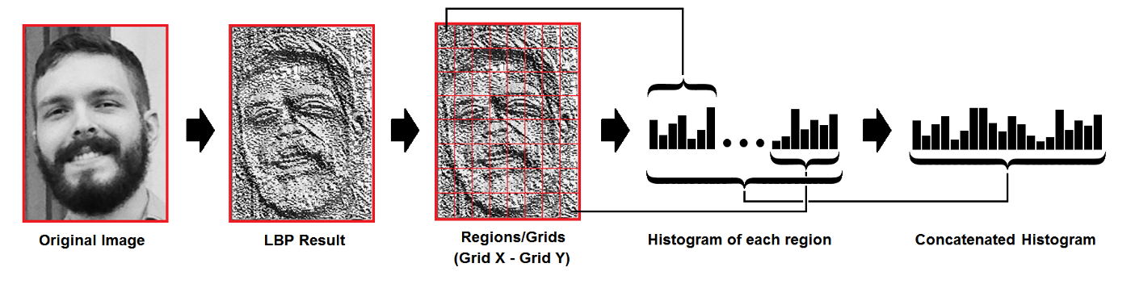
Extracting the Histograms: Now, using the image generated in the last step, we can use the Grid X and Grid Y parameters to divide the image into multiple grids, as can be seen in the following image:

Slide 10
Method and work-flow (scheme)
face detection and training
Feature Extraction
Face Recognition
Cascade Classifier, train model
Pre-Processing
Testing/predicting faces with LBPH operator

Slide 11
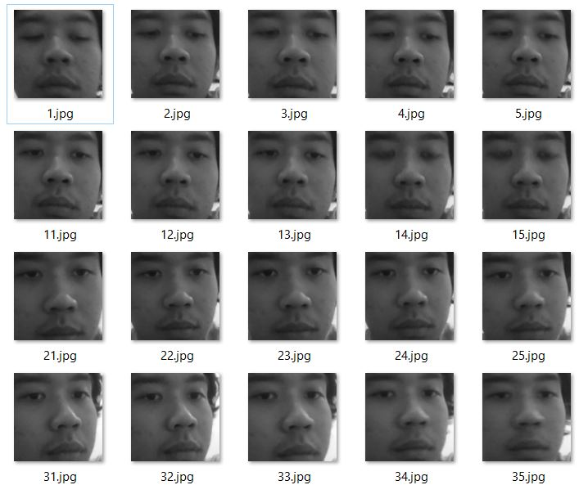
How does the training work?
At least 100 training images is generated by the first program (facetrain.py) using the LBP Cascade Classifier, so at least 100 histograms.
Resize and later match the histogram of test-data with the train-data.

Slide 12
Conclusions
The accuracy from the LBPH and LPH operator is pretty much very high all the time (accurate)
It provides and suitable for various lighting conditions which suits best for to be implemented in embedded systems
Although the classifier is just only for frontal faces, It can still detect the face for a slightly head tilts / rotate.
Still, the accuracy varies and depend on the lighting and webcam quality.

